Slide 1
RESP’s 101

Slide 2
RESP- Registered Education Savings Plan #1

Slide 3
Government will contribute a Canadian Education Savings Grant (CESG) to your RESP fund.
The government will contribute 20% to your fund in most cases. Ex) invest $100 and they will give you $20
For low income households they will contribute up to 40% to your fund Ex) invest $100 and they will give you $40

Slide 4
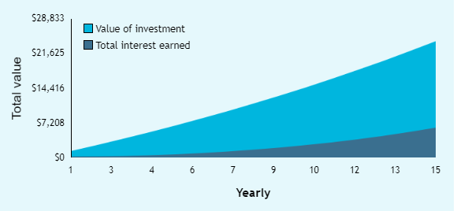
15 Years of investing $1000 per year
$1000 per year investment
$200 CESG per year
4% per year growth

Slide 5
Maximum GESG Rules
Maximum CESG per child -$7200 lifetime or $500 annually
Most families can’t contribute the $2500 annually when the child is young to maximize the CEGS. They are allowed to catch up one year at a time.
Example – A $5000 contribution would allow a parent to receive the CEGS grant of $500 for the current year and the $500 grant for the year that they missed.
Year 1 - $0 contribution =$0 GESG
Year 2- $5000 contribution = $500 CESG for year 1 and $500 CEGS for Year 2

Slide 6
RESP-Registered Education Savings Plan #2 Three Types of RESP Accounts

Slide 7
Types of RESP
Individual Plans | Family Plans
Opened for each child | Open one plan for all children
You can start and stop contributions without penalties You can choose from a Variety of investment options such as ETF’s, Mutual Funds, Stocks, Bonds and GIC’s.

Slide 8
Group Plan (Pooled Plan)
Pay into a shared plan that is managed by a fund manager
If you pull your money out you will loose the return on investment that you earned while your money was invested
Might have a sales charge as high as 10%

Slide 9
Withdrawing from an RESP (EAP)
An Education Assistance Payment is how you withdrawal money from your RESP. Your contribution can be withdrawn tax free while the portion from the CEGS and the interest earned on the entire fund is taxable.
Example- $1000 a year contribution with a $200 a year CESG
When you pull it out $15000 is tax free and the $3000 in CESG as well as the roughly $6000 in interest/return

Slide 10
What if you don’t want to go to School
The plan is collapsed the on Government takes back all of the CEGS contributions, the student can keep the contribution tax free and the interest return is taxed at the students marginal tax bracket plus a punitive tax of 20%.

